Slide 1
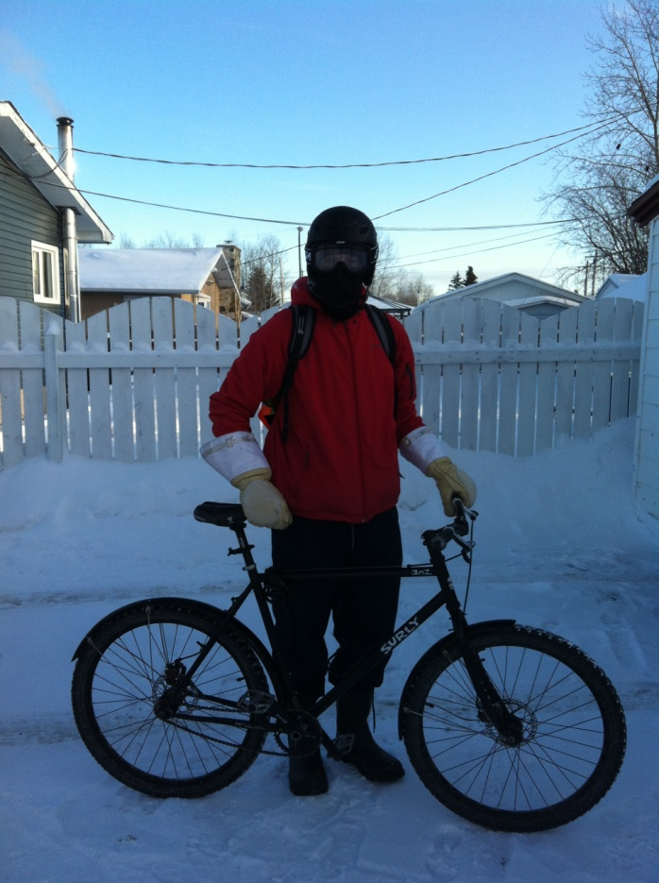
My Sweet Ride
Thompson MB

Slide 2
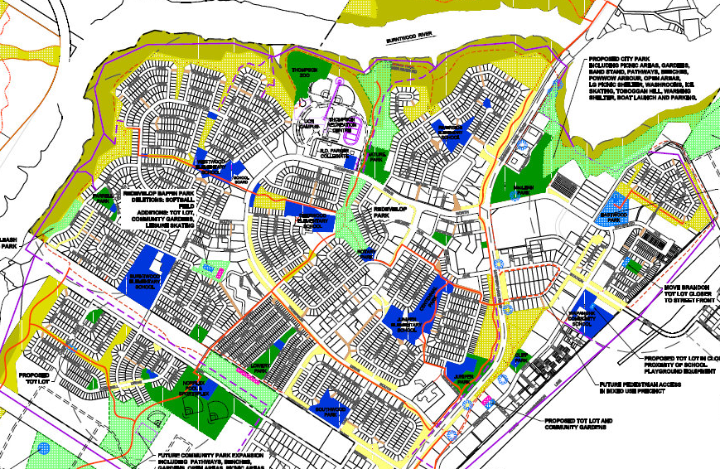
Proud of my Town
Thompson MB

Slide 3
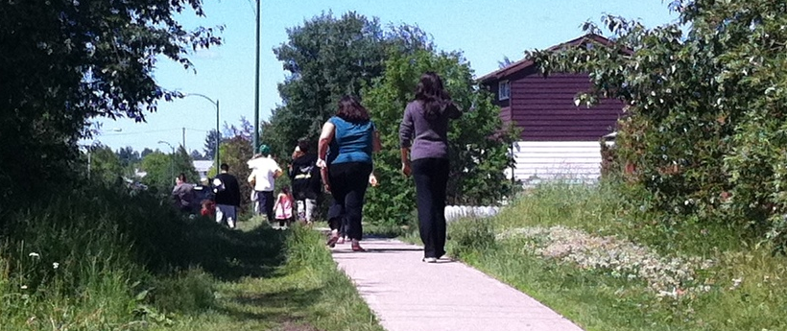
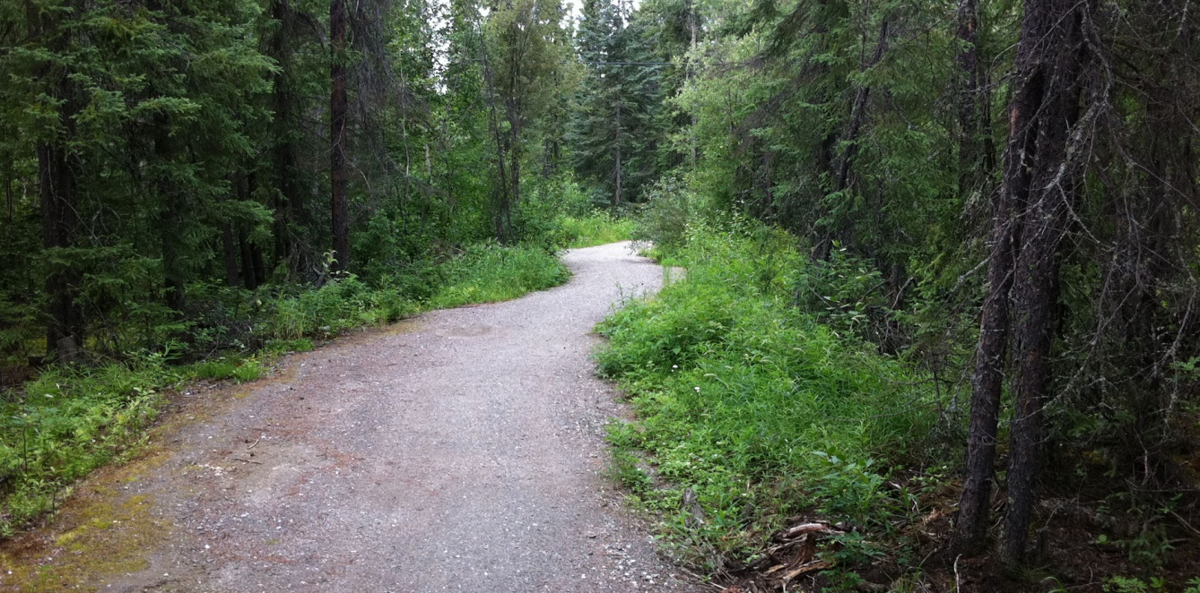
Proud of my Town
Cut Through
Millennium Trail
Thompson MB

Slide 4
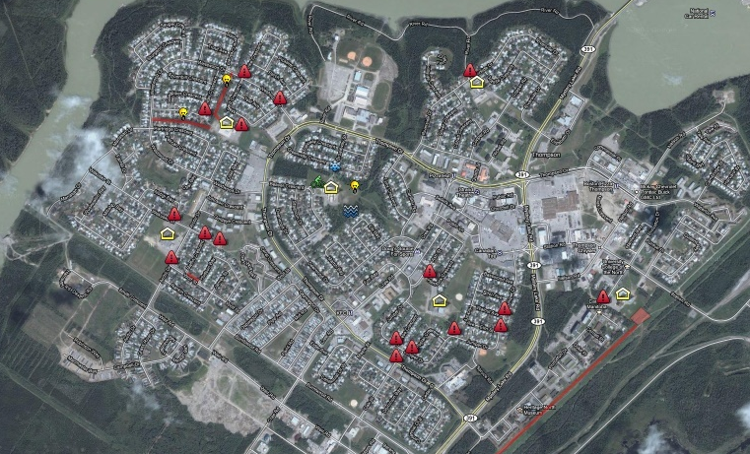
School Travel Planning
Thompson MB

Slide 5
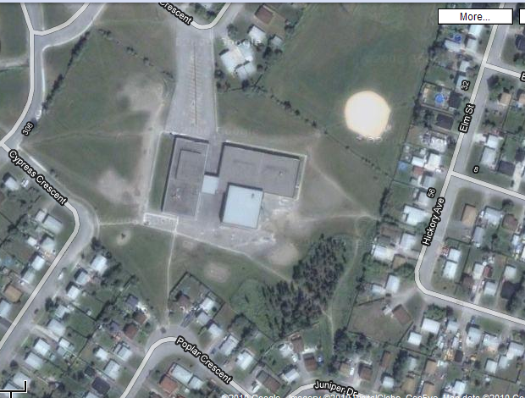
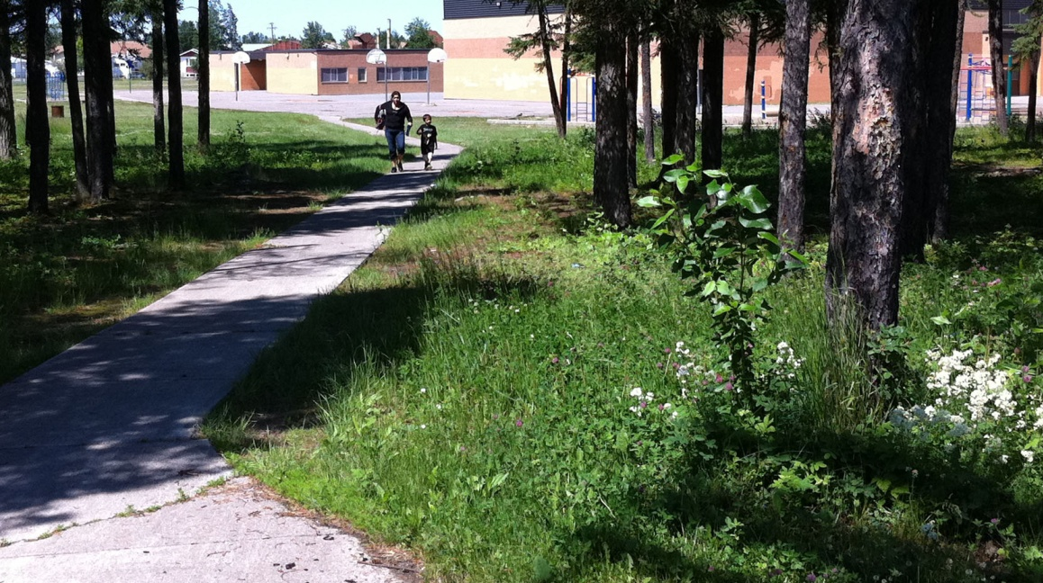
School Travel Planning
Thompson MB

Slide 6
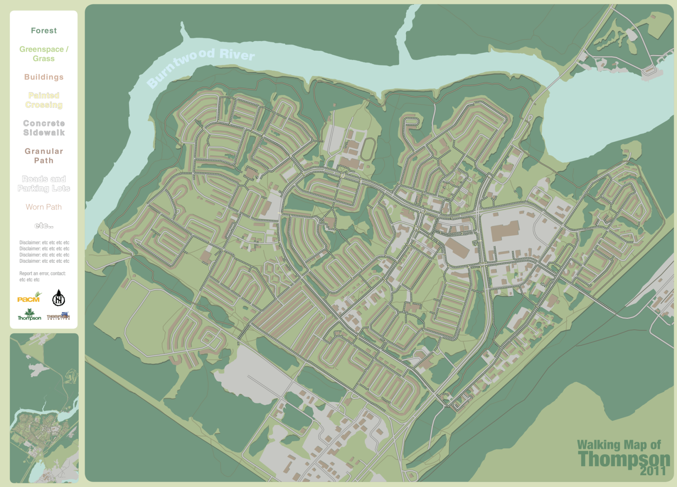
Active Transportation Map
Thompson MB

Slide 7

Active Transportation Map
Millennium Trail
Sidewalk
Informal Path
Desire Line
Thompson MB

Slide 9
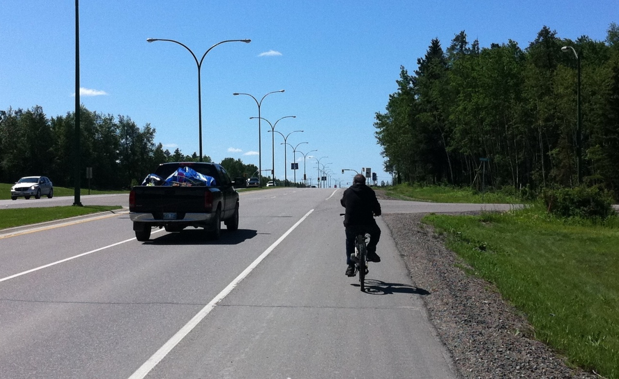
Couple Good Ideas
Active Riders Ride Free
Active Commuter Contest
Thompson MB

Slide 10
Thanks for Listening
Thompson MB

