Slide 1
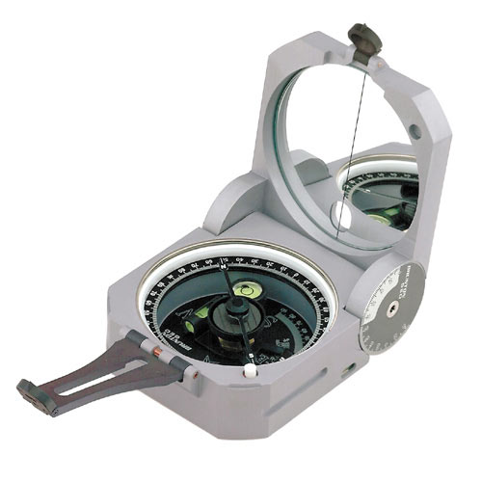


How much and how intense exercise needs to be to REALLY reach health benefits?
December 5, 2012
Dr. Danielle Bouchard
Assistant Professor
Faculty of Kinesiology and Recreation Management

Slide 2

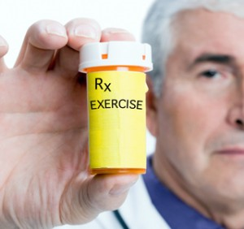
According to WHO, 2009
Four major mortality risks are:
Hypertension
Smoking
Elevated fasting glucose
Inactivity

Slide 3
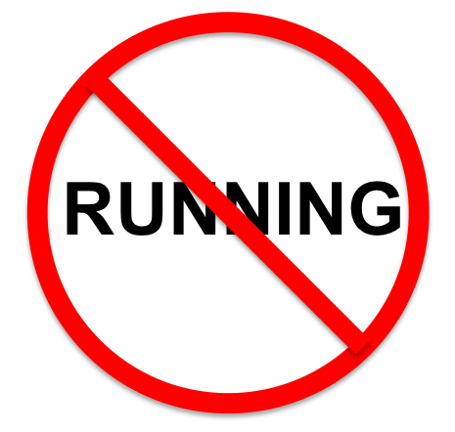
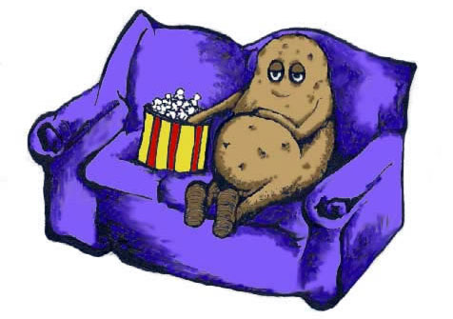
Difference between inactivity and sedentary

Slide 4
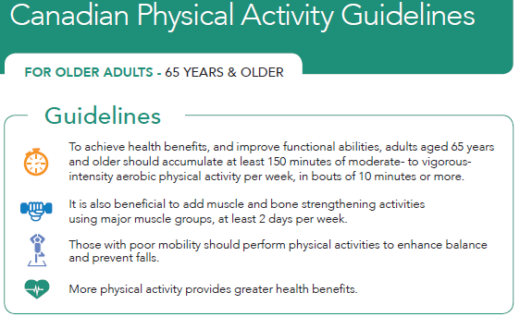
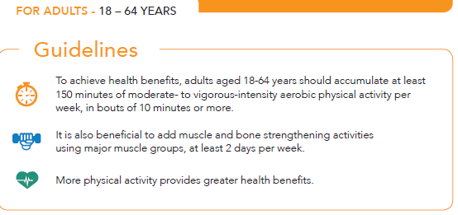
Canadian Physical Activity Guidelines: Aerobic component
≥150 minutes of aerobic physical activity per week at moderate- to vigorous- intensity.
www.csep.ca/guidelines

Slide 5
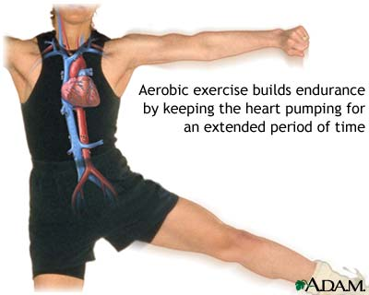

What types of activities count?
Focus on walking
Focus on aerobic exercise

Slide 6
What type of physical do you do most?
Walking
43.2 % of men and 48.4 % of women age 55 and older report walking as their major form of leisure activity (Simpson et al.,2003).
Other
5.8% of adults report swimming, 11% report cycling, and 8.6 % report weight training (Ham, et al.,2009).

Slide 7
Is walking enough?
LESS THAN 7% of those who walk as their primary mode of exercise reach the guidelines in terms of duration and intensity (Rafferty et al.,2002).
ONLY 1 person out of 38 was not able to reach moderate intensity by walking (Garcia et al., unpublished data).

Slide 8

Long walk or fast walk ?
Walking speed has a greater impact on reducing mortality risk than the total duration of walking!
Women who walked 30 to 60 minutes per day at high speed decreased their mortality risk by 44% compared with 12% for women who walked more than 2 hours per day at low speed.
Schnohr et al. (2007)

Slide 9
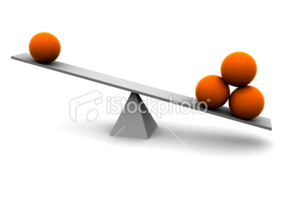
Direct and subjective measures
Direct measures (e.g., pedometer, accelerometer)
Subjective measure (i.e., questionnaire)
If you do 60 minutes you self-report from 17 minutes to 118 minutes.
Prince et al., 2008

Slide 10
Summer study
 | N = 36
Age (years) | 68.98 ± 6.67
Body mass index (kg/m²) | 35.8 ± 6.2
Mean steps in a week (steps per day) | 6392.6 ± 3474.1
Total weekly time reported exercising (min) | 462 (277 – 761)
Data presented as Mean ± SD or median (25-75th percentile) or N %

Slide 11
Summer study-2
Outcome | Mean steps in 7 days | Self-reported physical activity
Mean steps in 7 days | - | -.10
BMI | -.16 | -.05
Waist Circumference | -.16 | -.12
% Body Fat | -.14 | -.07
Arm Curl | .58* | -.30
Sit and Stand | .72*† | -.40
6- Minute Walk Test | .55* | -.23
Flexibility | .49* | -.21
Balance | .22 | -.11
* P<0.05 based on correlations of Spearman’s; † P<0.05 adjusted for chronic disease

Slide 12
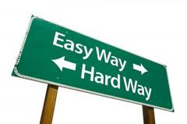
CONSEQUENCES
1- Find very easy to achieve the CPAG but not actually reaching it.
2- Find it very difficult to achieve the CPAG but already reaching it.

Slide 13
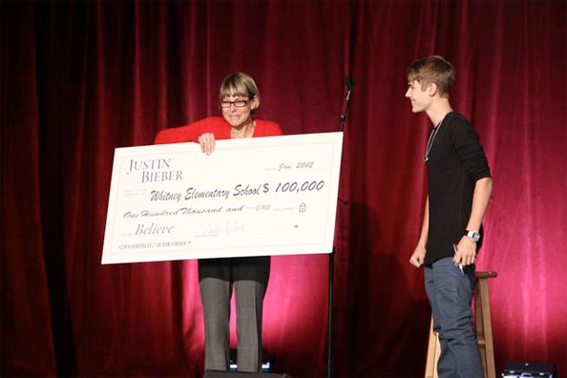
Something is better than nothing...
Why not optimize the health benefits of physical activity?

Slide 14

How many Canadians are reaching the CPAG?
Only 15.4 %!
(Colley et al, 2011)

Slide 15
How to reach the CPAG?
Fitness
Frequency
e.g.., 4X/week
Intensity
e.g., moderate
Duration
e.g.,
60 minutes

Slide 16
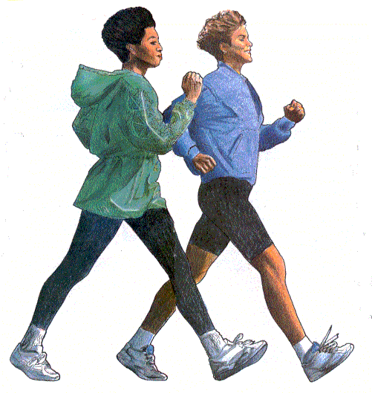
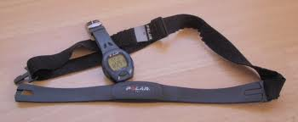
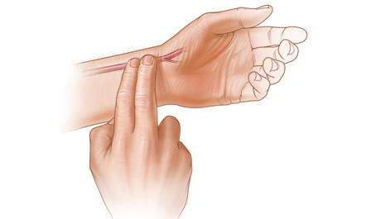
Three ways to measure moderate intensity ?
  Walking test (perceived exertion 4-6/10)
  Manual pulse
  Heart rate monitor
(55-69% HR max)
Warburton al. (2006)

Slide 17
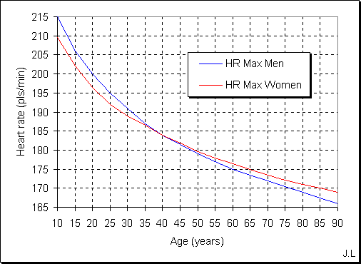
What is maximum HR ?
Max HR: 220 –age

Slide 18
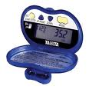
Another method to identify moderate intensity
  USING A PEDOMETER ?
10,000 steps per day
Why ?
Problems ?
  Cadence (≥ 100 steps/min)
Marshall al. (2009)

Slide 19

What method do you prefer ?

Slide 20
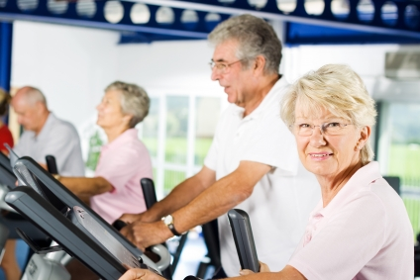
Perceived intensity in older adults?
Bouchard and Jones, submitted to Journal of Aging Research

Slide 21
Objectives
Capacity to identify moderate intensity in older adults.
Can you learn how to identify moderate intensity?
Can tools help you ?

Slide 22

Inclusion criteria
Men and women aged ≥ 65 years
Inactive (<2 sessions per week)
No training in cardiac rehabilitation
Not using medication acting influencing HR
No pacemaker

Slide 23
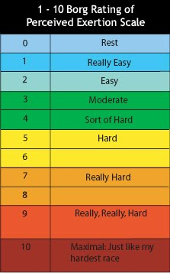
Methods
PRE-TESTING
8-week intervention
POST-TESTING
Notes:
Expliquer pourquoi Muscu meme si on a démontré que la masse maigre n’a pas de lien avec la CP

Slide 24
Results: Baseline characteristics
 | TOTAL (N=25)
Age | 71.9 ± 4.5
Male (%) | 12 (48.0%)
Sum of chronic conditions | 3.3 ± 1.6
Health risk factors
Body mass index (kg/m²) | At risk
Waist circumference (cm) | At risk
Systolic blood pressure (mmHg) | Normal
Diastolic blood pressure (mmHg) | Normal

Slide 25

Results: Moderate intensity
What kind of physical activity do you think a person of your age should AT LEAST do in order to derive health benefits?
Light
Moderate
Vigorous
Do not know
23/25 (92%)= Moderate

Slide 26
PA level pre-post
 | Pre | Post
# of PA minutes | 182 (106-384) | 255 (105-460)*
# of Moderate minutes | 5 (0-56) | 9 (0-46)
# steps per day | 5479 ± 3168 | 7312 ± 4263*
Median (25-75th percentile

Slide 27

PA level pre-post-2
Less than 1% at moderate intensity
 | Manual Pulse | Pedometer | HR Monitor
#min total PA | +58 | +120 | +88
#min moderate | +6 | +20 | -48
Steps/day | +278 | +2341 | +1797

Slide 28
Treadmill test
PRE: 22 %
POST:30 %
Best improvement in pedometer group

Slide 29
What about fit people?
 | (n=52)
Age | 34 (22-48)
How many minutes per week of exercise should you accumulate to derive health benefits ? | 222.6 ± 121.76
Moderate is the minimum intensity necessary to derive health benefits? | 43 (82.7%)
Steps per day during evaluation week | 13,765 (10,820-17,152)
Data presented as mean ± SD, median (25-75th percentiles) , or N (%)
5 out of 52: 9.6 %
All women

Slide 30

Next steps
In older adults
In fit individuals
Two-phase training with the pedometer
1- increase volume
2- increase intensity
N= 50
Age 65+
Learn the CPAG when they sign up to gym facility and learn how to reach the optimal intensity

Slide 31
How to get started with the pedometer?
Buy a pedometer ($8-20)!
Make sure it is accurately counting steps: walk 20 steps, then check to make sure the pedometer actually counted 20 steps +/- 2
When walking for exercise, walk at a cadence of 100 steps/minute or more
Calculate your steps/minute prescription:
  Ex: 20 min walk at 120 steps/minute = 2400 steps

Slide 32
Take home message
Some is better than none, but
more is better than some!

Slide 33
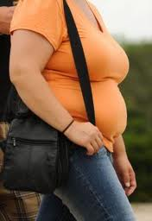
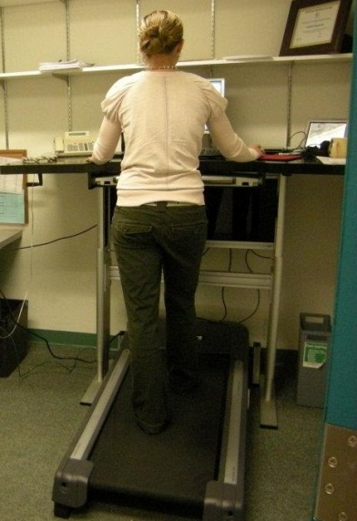
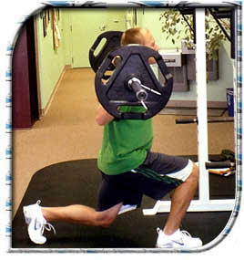
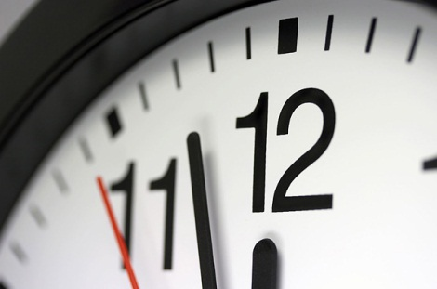
Other research interests

